Slide 1
Introduction to Data Science

Slide 2
Outline
Data, Big Data and Challenges
Data Science
Introduction
Why Data Science
Data Scientists
What do they do?
Python Introduction
Data Science libraries.

Slide 3

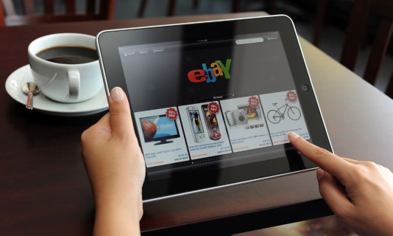
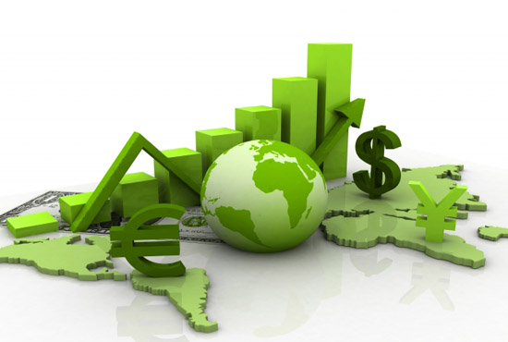

Data All Around
Lots of data is being collected and warehoused
Web data, e-commerce
Financial transactions, bank/credit transactions
Online trading and purchasing
Social Network

Slide 4
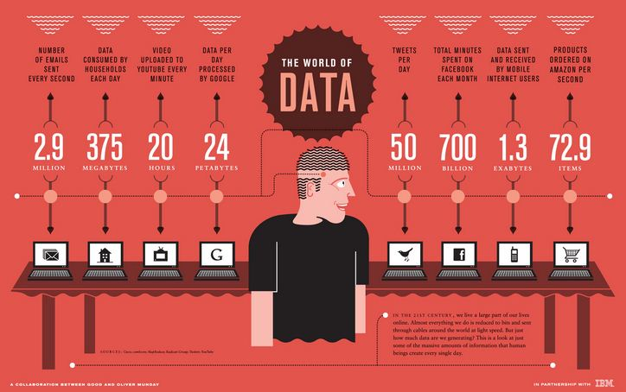
How Much Data Do We have?
Google processes 20 PB a day (2008)
Facebook has 60 TB of daily logs
eBay has 6.5 PB of user data + 50 TB/day (5/2009)
1000 genomes project: 200 TB
Cost of 1 TB of disk: $35
Time to read 1 TB disk: 3 hrs
(100 MB/s)

Slide 5
Big Data
Big Data is any data that is expensive to manage and hard to extract value from
Volume
The size of the data
Velocity
The latency of data processing relative to the growing demand for interactivity
Variety and Complexity
the diversity of sources, formats, quality, structures.

Slide 6
Types of Data We Have
Relational Data (Tables/Transaction/Legacy Data)
Text Data (Web)
Semi-structured Data (XML)
Graph Data
Social Network, Semantic Web (RDF), …
Streaming Data
You can afford to scan the data once

Slide 7
What To Do With These Data?
Aggregation and Statistics
Data warehousing and OLAP (Online analytical processing)
Indexing, Searching, and Querying
Keyword based search
Pattern matching (XML)
Knowledge discovery
Data Mining
Statistical Modeling

Slide 8
What is Data Science?
An area that manages, manipulates, extracts, and interprets knowledge from large amount of data
Data science (DS) is a multidisciplinary field of study with goal to address the challenges in big data
Data science principles apply to all data – big and small
https://hbr.org/2012/10/data-scientist-the-sexiest-job-of-the-21st-century/

Slide 9
What is Data Science?
Theories and techniques from many fields and disciplines are used to investigate and analyze a large amount of data to help decision makers in many industries such as science, engineering, economics, politics, finance, and education
Computer Science
Pattern recognition, visualization, data warehousing, High performance computing, Databases, AI
Mathematics
Mathematical Modeling
Statistics
Statistical and Stochastic modeling, Probability.

Slide 10
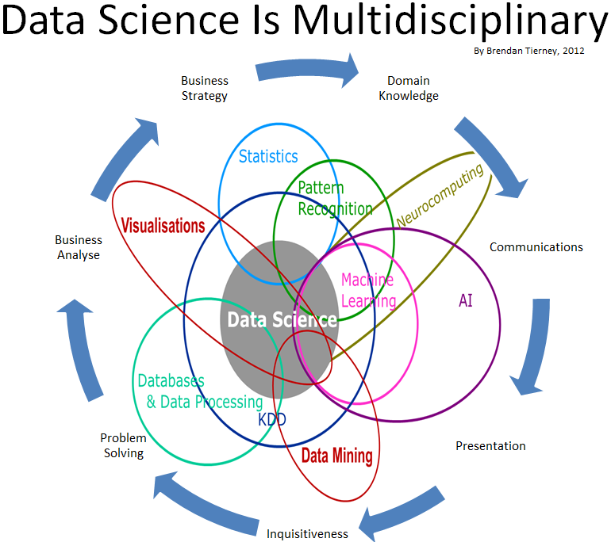
Data Science

Slide 11
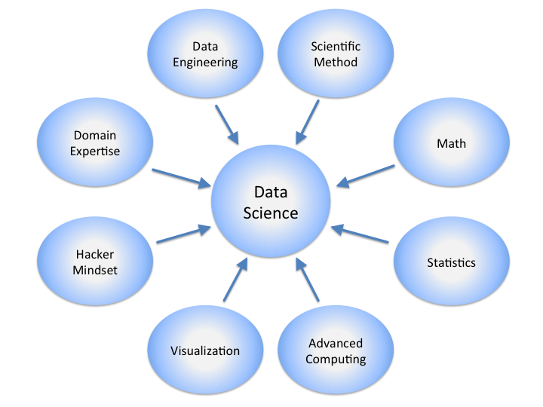
Data Science

Slide 12
Real Life Examples
Companies learn your secrets, shopping patterns, and preferences
For example, can we know if a woman is pregnant, even if she doesn’t want us to know? Target case study
Data Science and election (2008, 2012)
1 million people installed the Obama Facebook app that gave access to info on “friends”

Slide 13
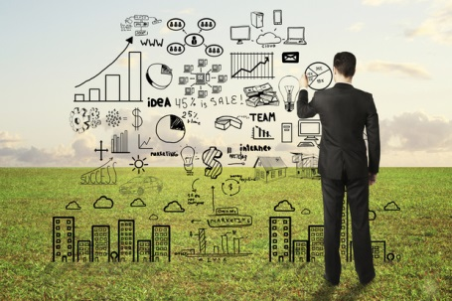
Data Scientists
Data Scientist
The highly paid Job of the 21st Century
They find stories, extract knowledge. They are not reporters

Slide 14

Data Scientists
Data scientists are the key to realizing the opportunities presented by big data. They bring structure to it, find compelling patterns in it, and advise executives on the implications for products, processes, and decisions

Slide 15
What do Data Scientists do?
National Security
Cyber Security
Business Analytics
Engineering
Healthcare
And more ….

Slide 16
Python programming

Slide 17
Overview of Python
Python is a high-level, interpreted language known for its readability and simplicity.
Developed in the late 1980s by Guido van Rossum, Python has evolved into one of the most popular programming languages.
It is widely used in various fields, especially data science, due to its extensive libraries and community support.

Slide 18
Why Python for Data Science?
Ease of Learning: Python’s syntax resembles English, making it accessible to beginners.
Community and Libraries: Massive support from the developer and scientific community. Key libraries for data science include:
NumPy (numerical operations)
Pandas (data manipulation)
Matplotlib and Seaborn (data visualization)
Scikit-Learn (machine learning)
Interdisciplinary Use: Python is versatile and is used in web development, machine learning, artificial intelligence, and automation—adding career flexibility.

Slide 19
Python Basics for Data Science

Slide 20
What is a variable?
A variable is a named memory block, which means it is a section of memory that can be accessed using a predetermined name.
In low-level programming languages, a variable must have its data type defined, as different data types require varying amounts of memory. However, Python is an interpreted language, so we don’t need to specify the data type of variables when declaring them explicitly.

Slide 21
Data Types & Structures:
Variables: Containers for storing data values. e.g., x = 10, name=‘Ali’
Basic Data Types:
int (integer),
float (decimal),
str (string),
bool (Boolean)

Slide 22
Modules
Files containing Python code, allowing for code organization and reusability.
Example:
import math, Import pandas, import numpy
To call a function from a module dot operator is used, for example
Pandas.Dataframe()

Slide 23
Input: Receiving Data from Users
Using input() function
input() is used to capture user input as a string.
Syntax: name = input(“Enter your name: ")
Note: input() always returns data as a string, so you may need to convert it for numerical input:
age = int(input("Enter your age: "))

Slide 24
Output: Displaying Data to Users
Using print() function
print() displays data on the screen.
Can output strings, variables, or even results of expressions.
print("Hello", "World“)
Common formatting:
Concatenation: Combine text with +
e.g., print("Name: " + name)
Formatted Strings (f-strings): Simplifies embedding expressions in strings:
print(f"Hello, {name}. You are {age} years old.")

Slide 25
Whitespace Formatting
Many languages use curly braces to delimit blocks of code. Python uses indentation:
for i in [1, 2, 3, 4, 5]: Print i # first line in "for i" block for j in [1, 2, 3, 4, 5]: print j # first line in "for j" block print i + j # last line in "for j" block print i # last line in "for i" block print "done looping“
This makes Python code very readable, but it also means that you have to be very careful with your formatting. Whitespace is ignored inside parentheses and brackets

